Slide 1
Linux Commands
Day: 2
Aleesha Joji
166574

Slide 2
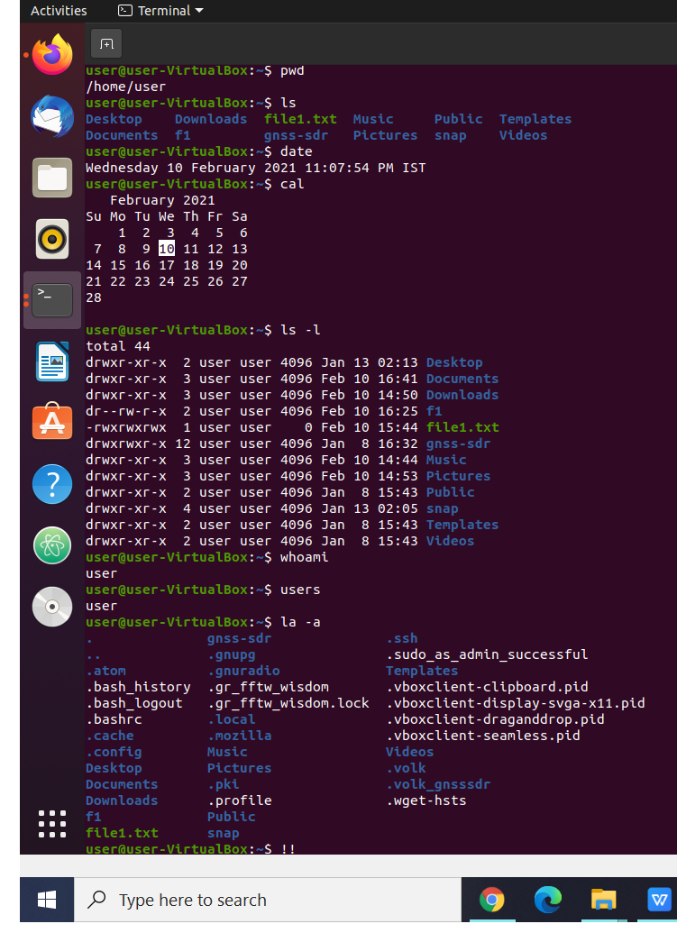
pwd - It prints the working directory
ls - Listing files or directories in Linux
date - Displays the system date and time
cal - Display the system Calender
ls -l - List the files and directories in long format
whoami - Displays the user name
users - Displays the user that is registered
la -a - Displays all the files including the hidden files
!! - Re-execute the previous command

Slide 3
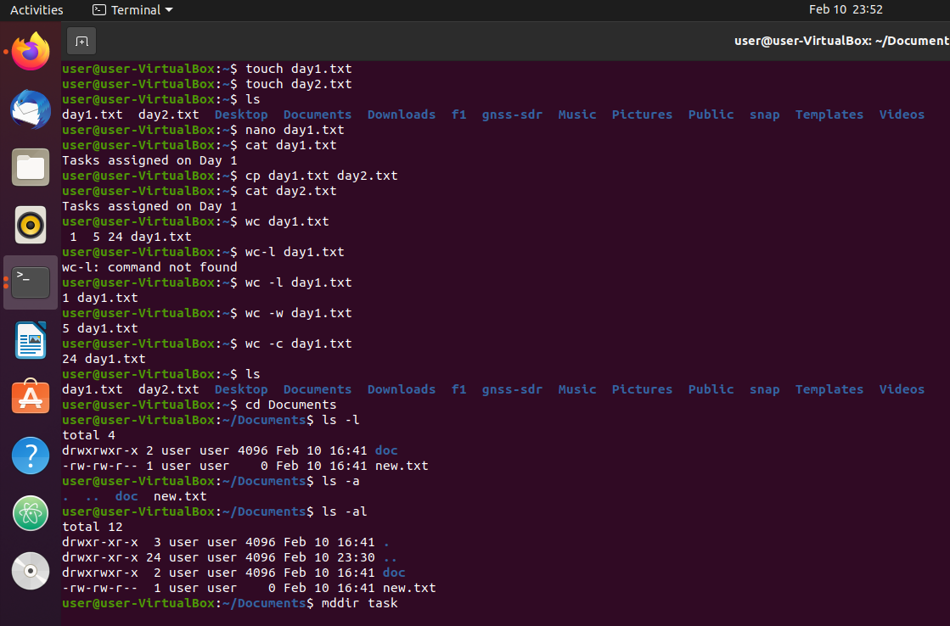
touch file - To create a new text file
nano file - To add contents in the file
cat file - Gives the contents of the file
cp file1 file2 - copy contents of file1 to 2
wc file - Count lines of words, characters and bytes
wc -l file - length of longest line
wc -w file - words in a file
wc -c file - count of bytes
mkdir name - Create a new directory

Slide 4
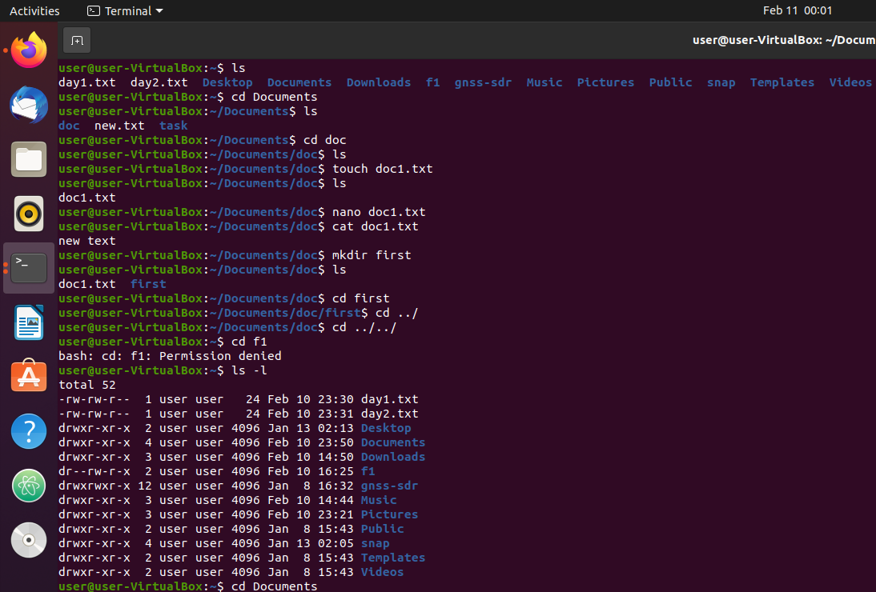
mkdir name - create a new directory
../ - Go back to previous directory
cd - change directory

Slide 5
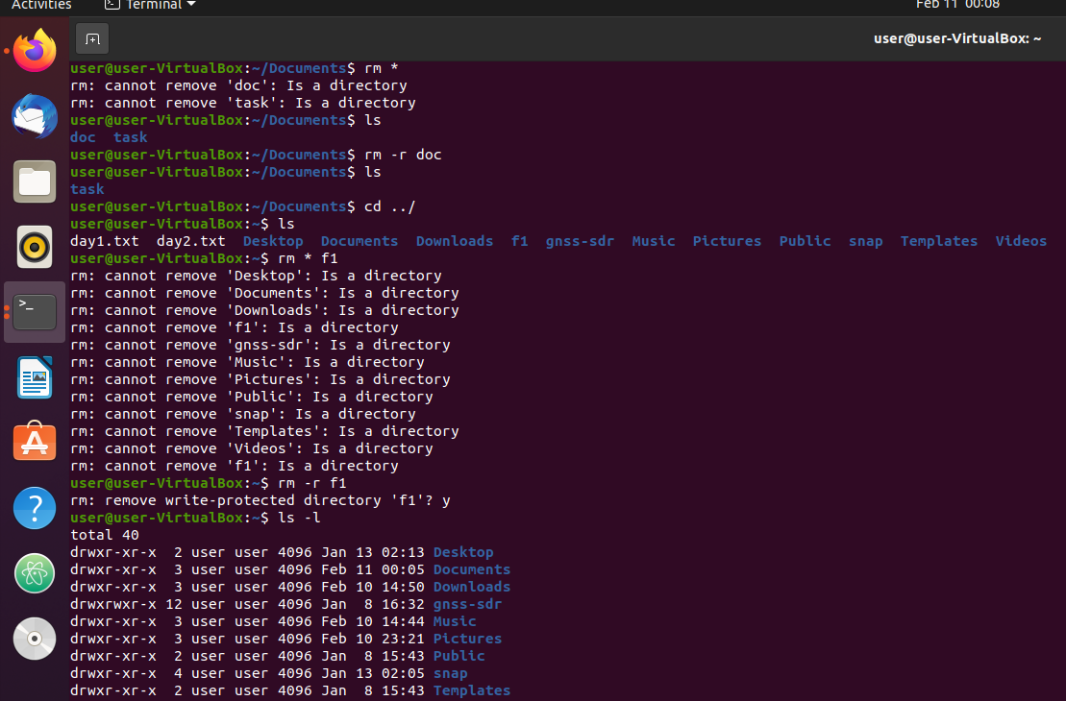
rm file - Removes a text file
rm -r name - removes a directroy
cd ../ - command directory
cd ../../ - navigate throung parent and child files

Slide 6
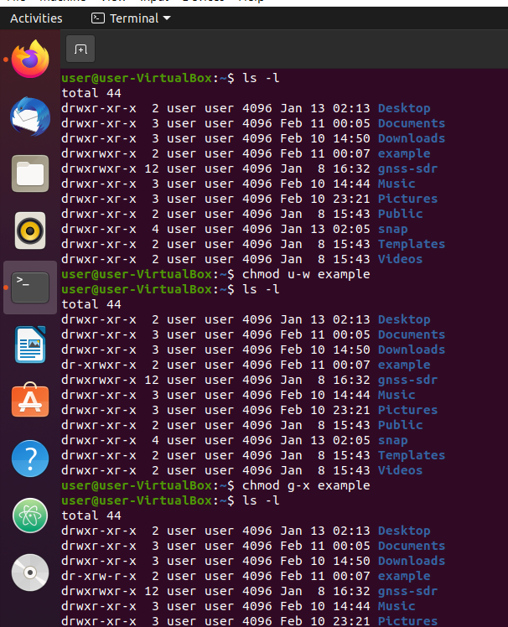
chmod u-w file - Change the access location of a file
g - group
o - others
a - all

Slide 7
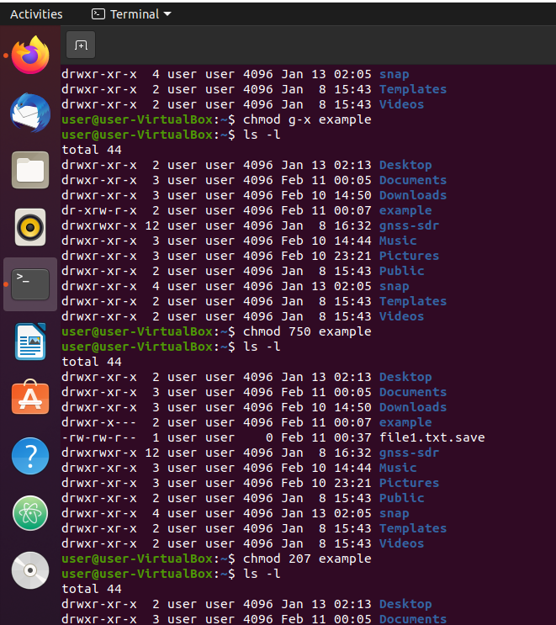
chmod octal file - Change the permission of file to octal,which can be found separately for user,group,world by
adding,
• 4-read(r)
• 2-write(w)
• 1-execute(x)

Slide 8
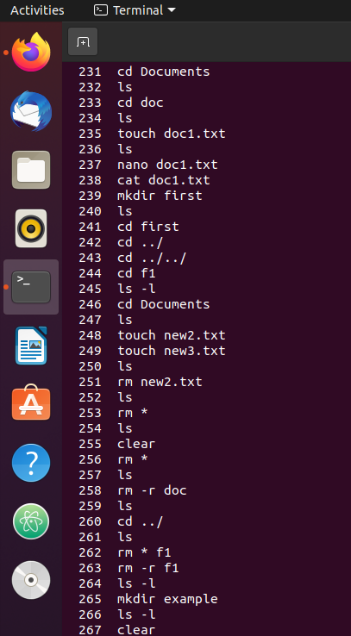
history - Views the previously typed commands
clear - Clear all the commands

Slide 9
THANK YOU

